Slide 1
Basic Data Visualization With Seaborn
Data Processing
Ph.D. Dang Thien Binh
IT Faculty, Da Nang University of Science and Technology

Slide 2
Seaborn
Seaborn is an amazing visualization library for statistical graphics plotting in Python. It is built on the top of matplotlib library and also closely integrated into the data structures from pandas.
Installation
For python environment :
pip install seaborn
For conda environment :
conda install seaborn

Slide 3
Let’s create Some basic plots using seaborn:
# Importing libraries
import numpy as np
import seaborn as sns
# Selecting style as white,
# dark, whitegrid, darkgrid
# or ticks
sns.set( style = "white" )
# Generate a random univariate
# dataset
rs = np.random.RandomState( 10 )
d = rs.normal( size = 50 )
# Plot a simple histogram and kde
# with binsize determined automatically
sns.distplot(d, kde = True, color = "g")

Slide 4
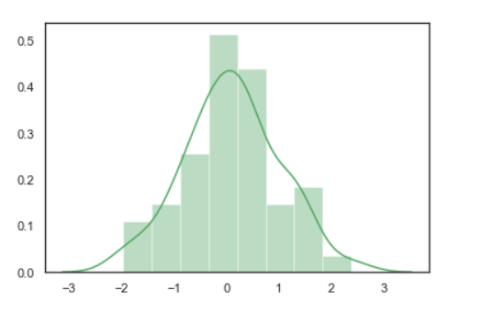
Output

Slide 5
Seaborn: statistical data visualization
These are the plot will help to visualize:
Line Plot
Scatter Plot
Box plot
Point plot
Count plot
Violin plot
Swarm plot
Bar plot
KDE Plot

Slide 6
Line plot:
Lineplot Is the most popular plot to draw a relationship between x and y with the possibility of several semantic groupings.
Syntax : sns.lineplot(x=None, y=None)
Parameters: x, y: Input data variables; must be numeric. Can pass data directly or reference columns in data.

Slide 7
Let’s visualize the data with a line plot and pandas:
# import module
import seaborn as sns
import pandas
# loading csv
data = pandas.read_csv("nba.csv")
# plotting lineplot
sns.lineplot( data['Age'], data['Weight'])

Slide 8
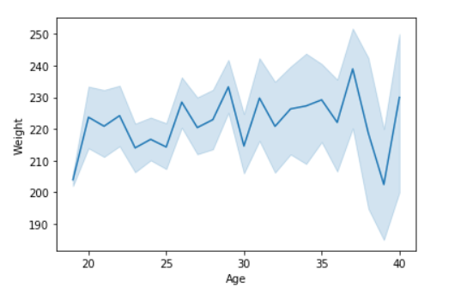
There is line shadow showing the confidence interval, because the dataset contains multiple y(team_strikerate) values for each x(season) value. By default, sns.lineplot() will estimate the mean by aggregating over multiple y values at each x value.
After aggregation, the mean of y values at each x value will be plotted as a line. The line shadow represents the confidence interval of the estimate.

Slide 9
Example 2: Use the hue parameter for plotting the graph.
In seaborn, the hue parameter determines which column in the data frame should be used for colour encoding.
# import module
import seaborn as sns
import pandas
# read the csv data
data = pandas.read_csv("nba.csv")
# plot
sns.lineplot(data['Age'],data['Weight'], hue =data["Position"])

Slide 10
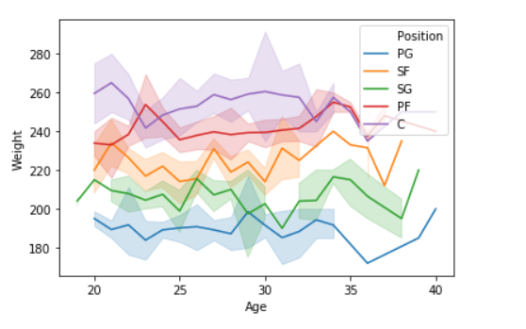

Slide 11
Scatter Plot:
Scatterplot Can be used with several semantic groupings which can help to understand well in a graph against continuous/categorical data. It can draw a two-dimensional graph.
Syntax: seaborn.scatterplot(x=None, y=None)
Parameters: x, y: Input data variables that should be numeric.
Returns: This method returns the Axes object with the plot drawn onto it.

Slide 12
Let’s visualize the data with a scatter plot and pandas:
# import module
import seaborn
import pandas
# load csv
data = pandas.read_csv("nba.csv")
# plotting
seaborn.scatterplot(data['Age'],data['Weight'])

Slide 13
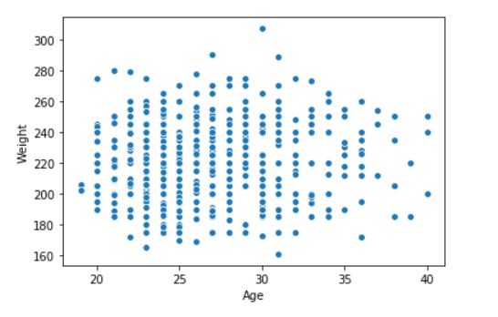

Slide 14
Use the hue parameter for plotting the graph.
import seaborn
import pandas
data = pandas.read_csv("nba.csv")
seaborn.scatterplot( data['Age'], data['Weight'], hue =data["Position"])

Slide 15
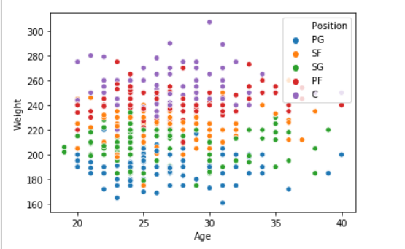

Slide 16
Box plot:
A box plot (or box-and-whisker plot) s is the visual representation of the depicting groups of numerical data through their quartiles against continuous/categorical data.
A box plot consists of 5 things.
Minimum
First Quartile or 25%
Median (Second Quartile) or 50%
Third Quartile or 75%
Maximum

Slide 17
Box plot:
Syntax:
seaborn.boxplot(x=None, y=None, hue=None, data=None)
Parameters:
x, y, hue: Inputs for plotting long-form data.
data: Dataset for plotting. If x and y are absent, this is interpreted as wide-form.
Returns: It returns the Axes object with the plot drawn onto it.

Slide 18
Draw the box plot with Pandas:
# import module
import seaborn as sns
import pandas
# read csv and plotting
data = pandas.read_csv( "nba.csv" )
sns.boxplot( data['Age'] )

Slide 19
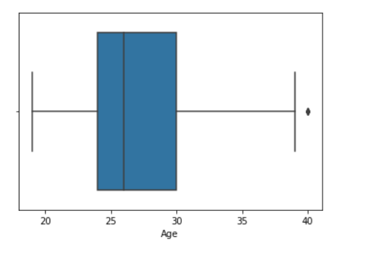
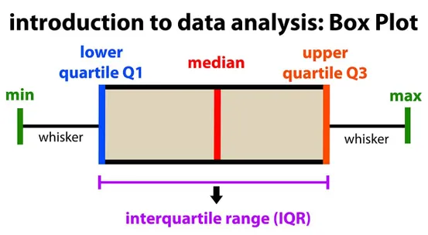

Slide 20
Example 2
# import module
import seaborn as sns
import pandas
# read csv and plotting
data = pandas.read_csv( "nba.csv" )
sns.boxplot( data['Age'], data['Weight'])

Slide 21
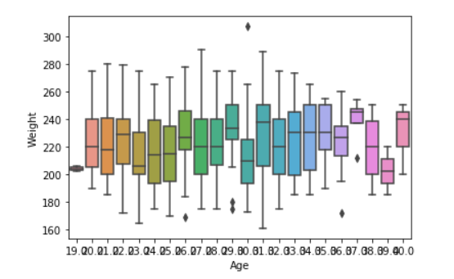

Slide 22
Violin Plot:
A violin plot is similar to a boxplot. It shows several quantitative data across one or more categorical variables such that those distributions can be compared.
Syntax: seaborn.violinplot(x=None, y=None, hue=None, data=None)
Parameters:
x, y, hue: Inputs for plotting long-form data.
data: Dataset for plotting.

Slide 23
Draw the violin plot with Pandas:
# import module
import seaborn as sns
import pandas
# read csv and plot
data = pandas.read_csv("nba.csv")
sns.violinplot(data['Age'])

Slide 24
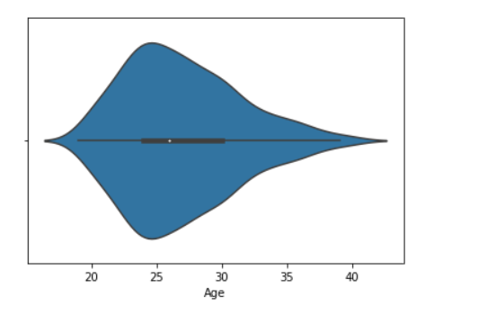

Slide 25
Example 2
# import module
import seaborn
seaborn.set(style = 'whitegrid')
# read csv and plot
data = pandas.read_csv("nba.csv")
seaborn.violinplot(x ="Age", y ="Weight",data = data)

Slide 26
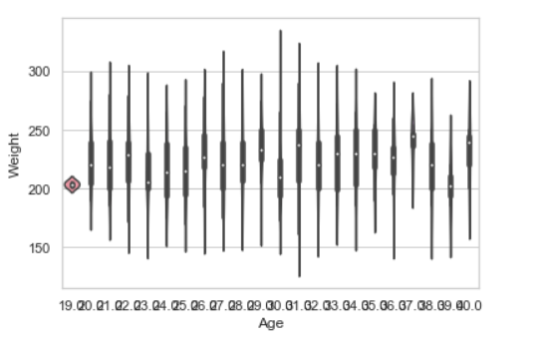

Slide 27
Swarm plot:
A swarm plot is similar to a strip plot, We can draw a swarm plot with non-overlapping points against categorical data.
Syntax: seaborn.swarmplot(x=None, y=None, hue=None, data=None)
Parameters:
x, y, hue: Inputs for plotting long-form data.
data: Dataset for plotting.

Slide 28
Draw the swarm plot with Pandas:
# import module
import seaborn
seaborn.set(style = 'whitegrid')
# read csv and plot
data = pandas.read_csv( "nba.csv" )
seaborn.swarmplot(x = data["Age"])

Slide 29
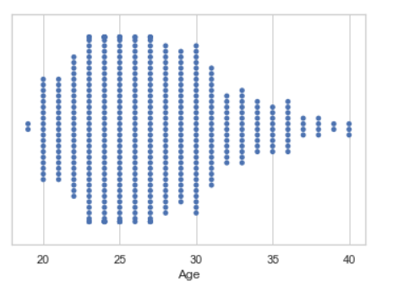

Slide 30
Example 2
# import module
import seaborn
seaborn.set(style = 'whitegrid')
# read csv and plot
data = pandas.read_csv("nba.csv")
seaborn.swarmplot(x ="Age", y ="Weight",data = data)

Slide 31
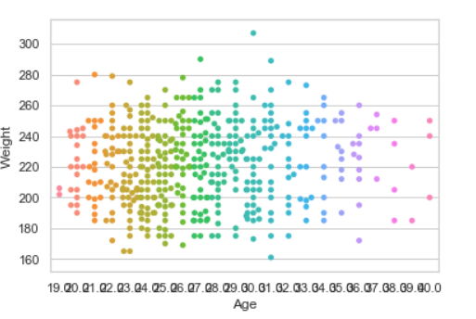

Slide 32
Bar plot:
Barplot represents an estimate of central tendency for a numeric variable with the height of each rectangle and provides some indication of the uncertainty around that estimate using error bars.
Syntax : seaborn.barplot(x=None, y=None, hue=None, data=None)
Parameters :
x, y : This parameter take names of variables in data or vector data, Inputs for plotting long-form data.
hue : (optional) This parameter take column name for colour encoding.
data : (optional) This parameter take DataFrame, array, or list of arrays, Dataset for plotting. If x and y are absent, this is interpreted as wide-form. Otherwise it is expected to be long-form.
Returns : Returns the Axes object with the plot drawn onto it.

Slide 33
Draw the bar plot with Pandas
# import module
import seaborn
seaborn.set(style = 'whitegrid')
# read csv and plot
data = pandas.read_csv("nba.csv")
seaborn.barplot(x =data["Age"])

Slide 34
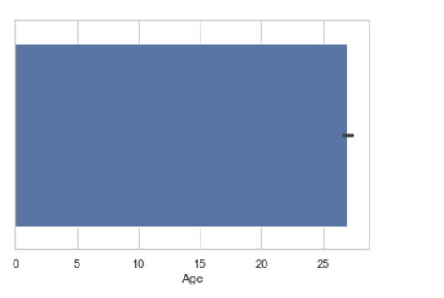

Slide 35
Example 2
# import module
import seaborn
seaborn.set(style = 'whitegrid')
# read csv and plot
data = pandas.read_csv("nba.csv")
seaborn.barplot(x ="Age", y ="Weight", data = data)

Slide 36
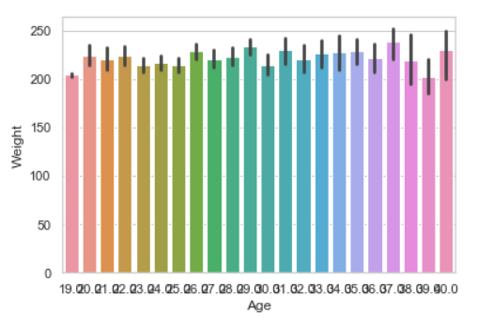

Slide 37
Point plot:
Point plot used to show point estimates and confidence intervals using scatter plot glyphs. A point plot represents an estimate of central tendency for a numeric variable by the position of scatter plot points and provides some indication of the uncertainty around that estimate using error bars.
Syntax: seaborn.pointplot(x=None, y=None, hue=None, data=None)
Parameters:
x, y: Inputs for plotting long-form data.
hue: (optional) column name for color encoding.
data: dataframe as a Dataset for plotting.
Return: The Axes object with the plot drawn onto it.

Slide 38
Draw the point plot with Pandas:
# import module
import seaborn
seaborn.set(style = 'whitegrid')
# read csv and plot
data = pandas.read_csv("nba.csv")
seaborn.pointplot(x = "Age", y = "Weight", data = data)

Slide 39
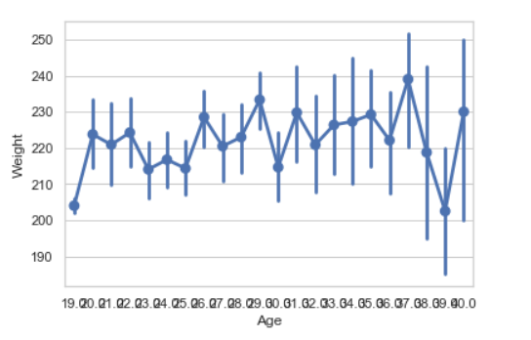

Slide 40
Count plot:
Count plot used to Show the counts of observations in each categorical bin using bars.
Syntax : seaborn.countplot(x=None, y=None, hue=None, data=None)
Parameters :
x, y: This parameter take names of variables in data or vector data, optional, Inputs for plotting long-form data.
hue : (optional) This parameter take column name for color encoding.
data : (optional) This parameter take DataFrame, array, or list of arrays, Dataset for plotting. If x and y are absent, this is interpreted as wide-form. Otherwise, it is expected to be long-form.
Returns: Returns the Axes object with the plot drawn onto it.

Slide 41
Draw the count plot with Pandas:
# import module
import seaborn
seaborn.set(style = 'whitegrid')
# read csv and plot
data = pandas.read_csv("nba.csv")
seaborn.countplot(data["Age"])

Slide 42
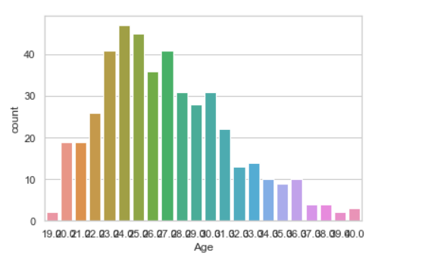

Slide 43
KDE Plot:
KDE Plot described as Kernel Density Estimate is used for visualizing the Probability Density of a continuous variable. It depicts the probability density at different values in a continuous variable. We can also plot a single graph for multiple samples which helps in more efficient data visualization.
Syntax: seaborn.kdeplot(x=None, *, y=None, vertical=False, palette=None, **kwargs)
Parameters:
x, y : vectors or keys in data
vertical : boolean (True or False)
data : pandas.DataFrame, numpy.ndarray, mapping, or sequence

Slide 44
Draw the KDE plot with Pandas:
# importing the required libraries
from sklearn import datasets
import pandas as pd
import seaborn as sns
# Setting up the Data Frame
iris = datasets.load_iris()
iris_df = pd.DataFrame(iris.data, columns=['Sepal_Length',
'Sepal_Width', ‘Petal_Length', 'Petal_Width'])
iris_df['Target'] = iris.target
iris_df['Target'].replace([0], 'Iris_Setosa', inplace=True)
iris_df['Target'].replace([1], 'Iris_Vercicolor', inplace=True)
iris_df['Target'].replace([2], 'Iris_Virginica', inplace=True)
# Plotting the KDE Plot
sns.kdeplot(iris_df.loc[(iris_df['Target'] =='Iris_Virginica'),
'Sepal_Length'], color = 'b', shade = True, Label ='Iris_Virginica')

Slide 45
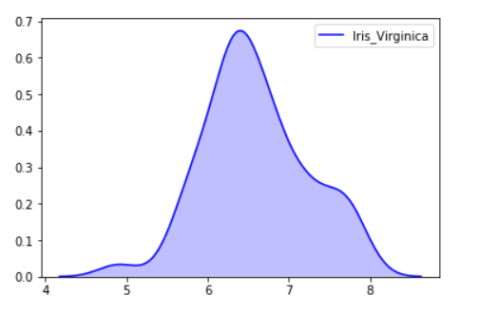

Slide 46
Example 2
# import module
import seaborn as sns
import pandas
# read top 5 column
data = pandas.read_csv("nba.csv").head()
sns.kdeplot( data['Age'], data['Number'])

Slide 47
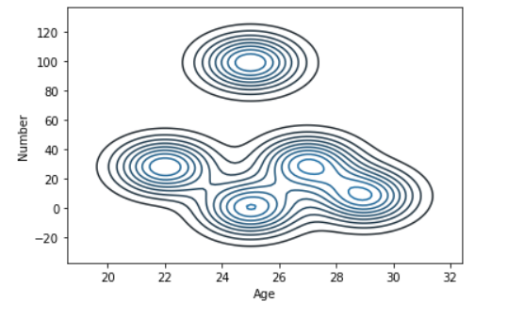

Slide 48
Bivariate and Univariate data using seaborn and pandas:
Bivariate data: This type of data involves two different variables. The analysis of this type of data deals with causes and relationships and the analysis is done to find out the relationship between the two variables.
Univariate data: This type of data consists of only one variable. The analysis of univariate data is thus the simplest form of analysis since the information deals with only one quantity that changes. It does not deal with causes or relationships and the main purpose of the analysis is to describe the data and find patterns that exist within it.

Slide 49
Let’s see an example of Bivariate data :
# import module
import seaborn as sns
import pandas
# read csv and plotting
data = pandas.read_csv( "nba.csv" )
sns.boxplot( data['Age'], data['Height'])

Slide 50
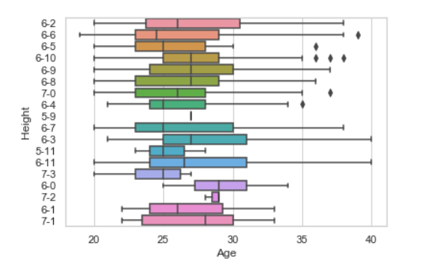

Slide 51
using KDE plot.
# import module
import seaborn as sns
import pandas
# read top 5 column
data = pandas.read_csv("nba.csv").head()
sns.kdeplot( data['Age'], data['Weight'])

Slide 52
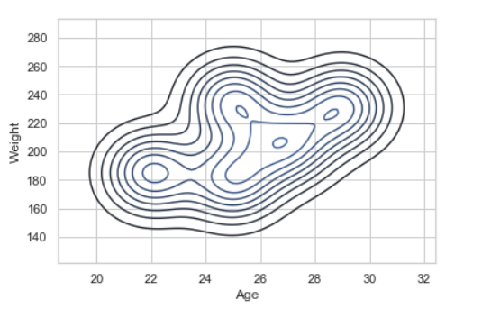

Slide 53
Let’s see an example of univariate data distribution:
# import module
import seaborn as sns
import pandas
# read top 5 column
data = pandas.read_csv("nba.csv").head()
sns.distplot( data['Age'])

Slide 54
